Slide 1


Meta Story 1080 x 1920
PowerPoint Template
HOW TO USE
After customizing the templates,
go to: File > Save as >
JPG image > Current slide
#CubScouts #CubScoutFun
www.ScoutingAZ.com

Slide 2

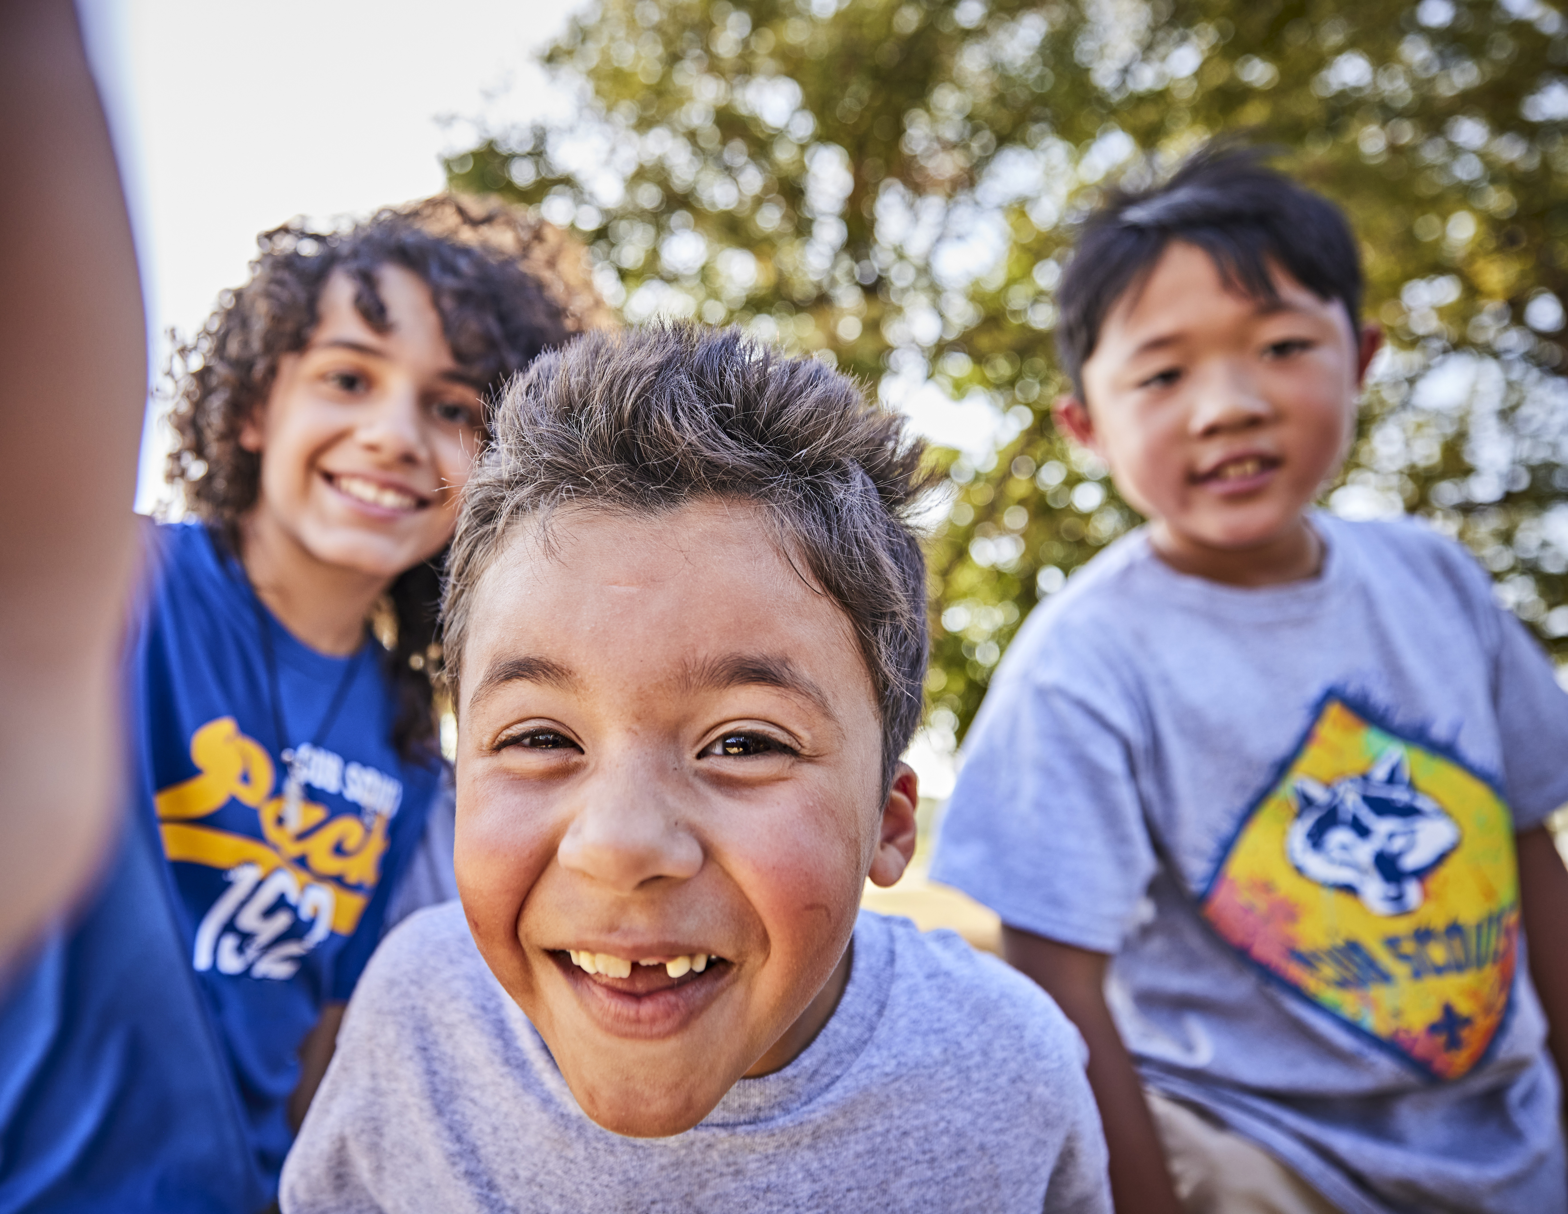
Cub Scouting is fun
with friends in the
great outdoors!
Cub Scouting is fun with friends in the great outdoors!
It’s camping, crafts, pinewood derby cars,
hands-on learning, &
much more!

Slide 3

Cub Scouting is fun
with friends in the
great outdoors!
It’s camping, crafts, pinewood derby cars,
hands-on learning, &
much more!

Slide 4

Cub Scouting es diversion con amigos al aire libre!
Campamentos, artesanias, pinewood derby autos, aprendizaje practico, y mucho mas

